Slide 1
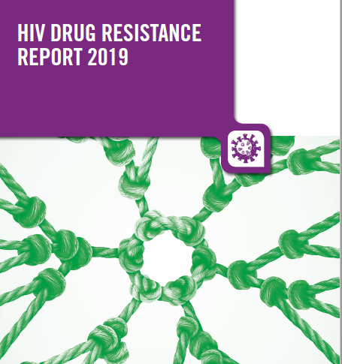
Surveillance of
HIV Drug Resistance in low- and middle- income countries
Silvia Bertagnolio, MD
HIV Department
World Health Organization

Slide 2
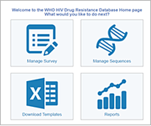


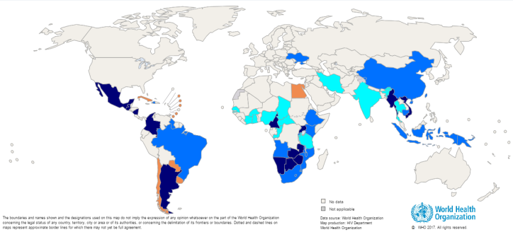
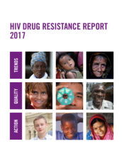


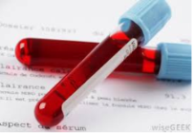
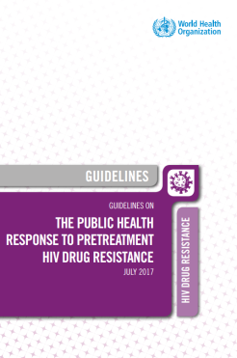
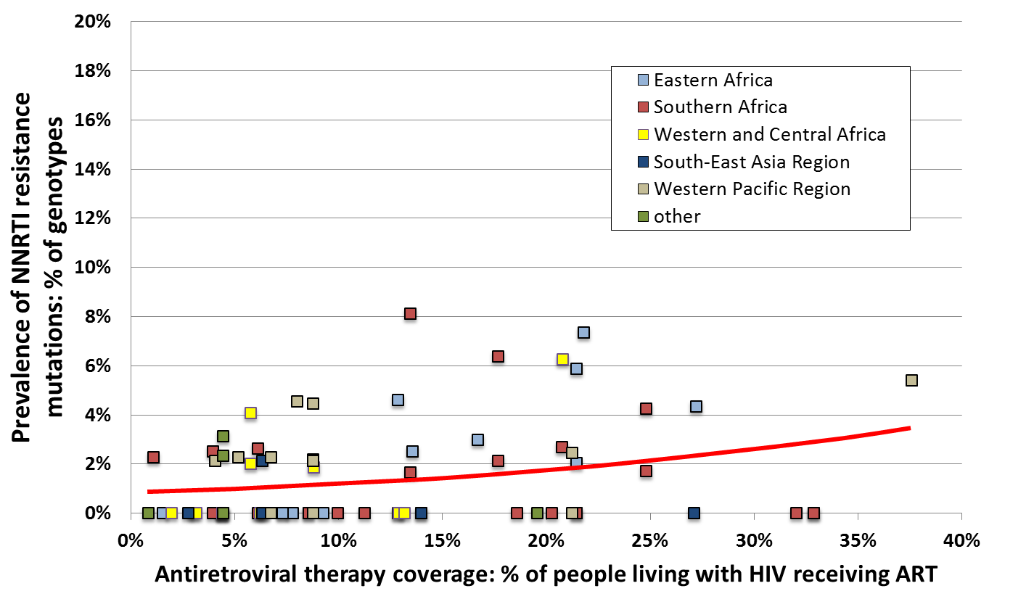
Use of HIVDR Data to Inform Global Trends and ART Regimens
WHO (HIVDR Database)
HIVDR data (Epi+Lab) QA, analysed and interpreted
De-identified patient data
Produce National Report and inform national policies
Country
Sequence data
Contribute to WHO’s Global Report
Blood specimens
Global HIVDR Laboratory Network
Assess evolution of the HIVDR epidemic
Response: inform treatment guidelines

Slide 3
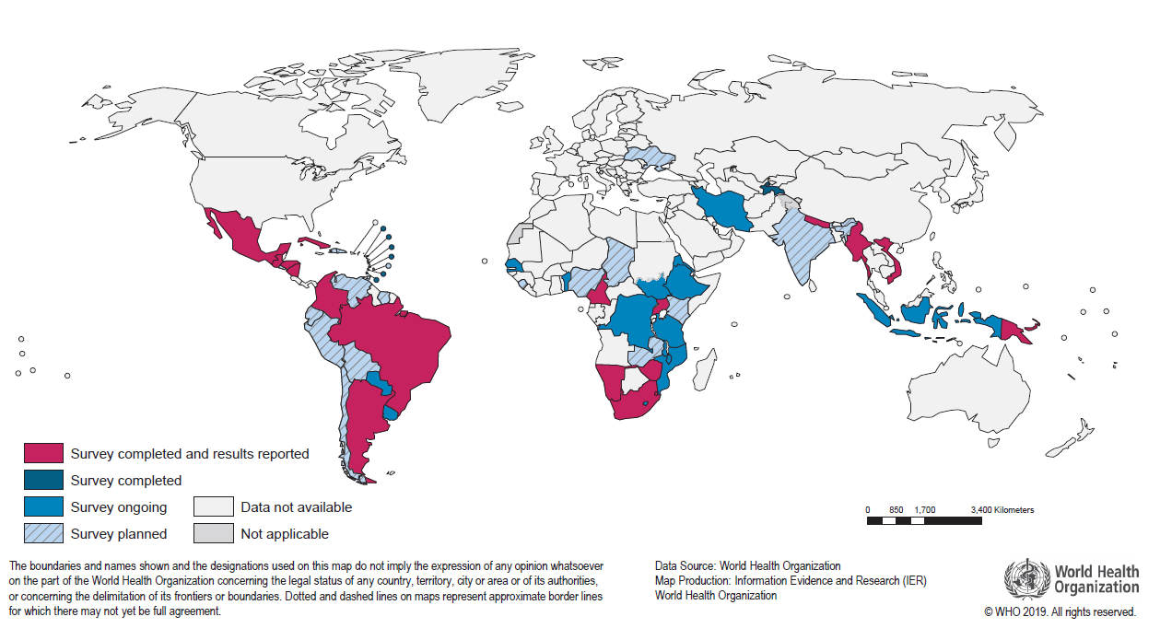
Nationally Representative Surveys of Pretreatment HIVDR (PDR) among Adults Initiating ART (2014-2018)
39 countries started
25 completed
14 ongoing
18 planned
2019 WHO HIVDR Report

Slide 4
Prevalence of PDR to NNRTI, by Country
PDR NNRTI >10%
Africa (5): South Africa, Uganda,
Namibia, Zimbabwe, Eswatini;
Central/South America (5): Argentina, Honduras, Cuba, Nicaragua, Guatemala;
South East Asia (2): Nepal, PNG.
2019 WHO HIVDR Report

Slide 5
Prevalence of PDR, by Drug and by Country
0-4.5%
0-5.7%
2019 WHO HIVDR Report

Slide 6
Prevalence of NNRTI PDR, by Gender
Pooled analysis of country data:
NNRTI PDR is significantly higher in women (11.8%) vs men (7.8%) p=0.005

Slide 7
Prevalence of NNRTI PDR among First-Line Initiators, by Reported Prior Exposure to ARV Drugs
NNRTI PDR is nearly 3 times higher in ART re-initiators reporting prior ARVs exposure: 21.1% (prior ARV drug exposed) vs 7.8% (naive); p≤0.0001.

Slide 8
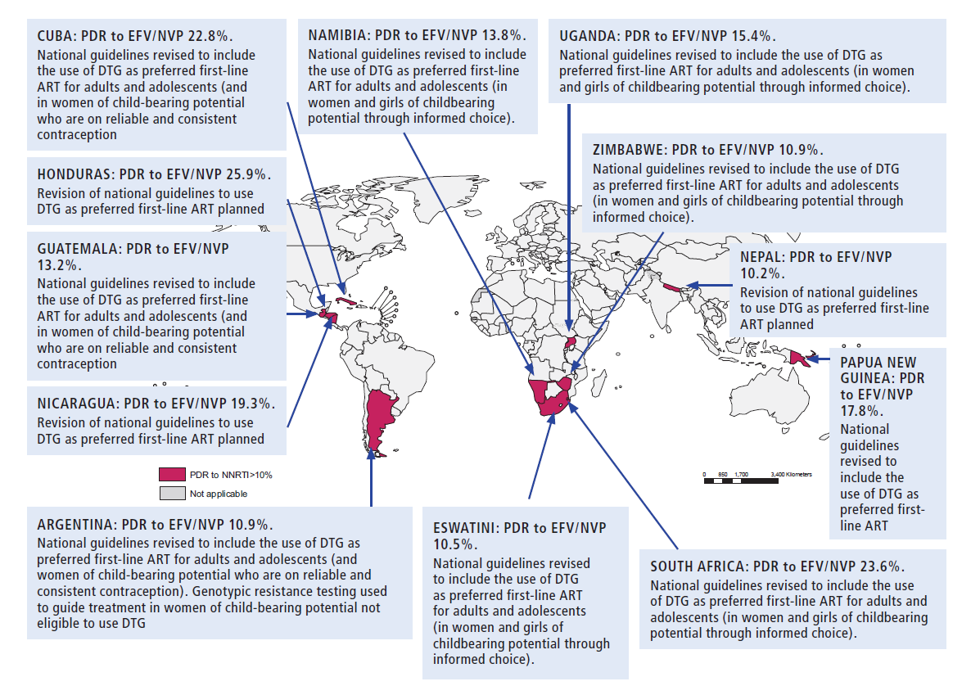
Response in Countries with PDR to NNRTI>10%

Slide 9
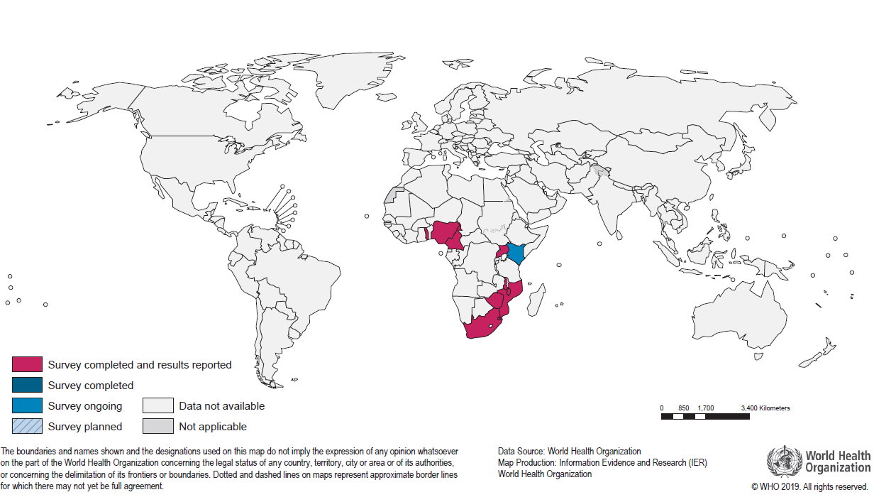
Nationally Representative Surveys of Pretreatment HIVDR (PDR) among Infants < 18 months Newly Diagnosed with HIV and Treatment Naive (2012-2018)
9 completed,
1 ongoing,
2 planned
Notes:
In this survey, infants < 18 months …are

Slide 10
Prevalence of NNRTI PDR in Infants, by Country
1 out of 2 newly diagnosed infants have HIV with EFV/NVP resistance

Slide 11
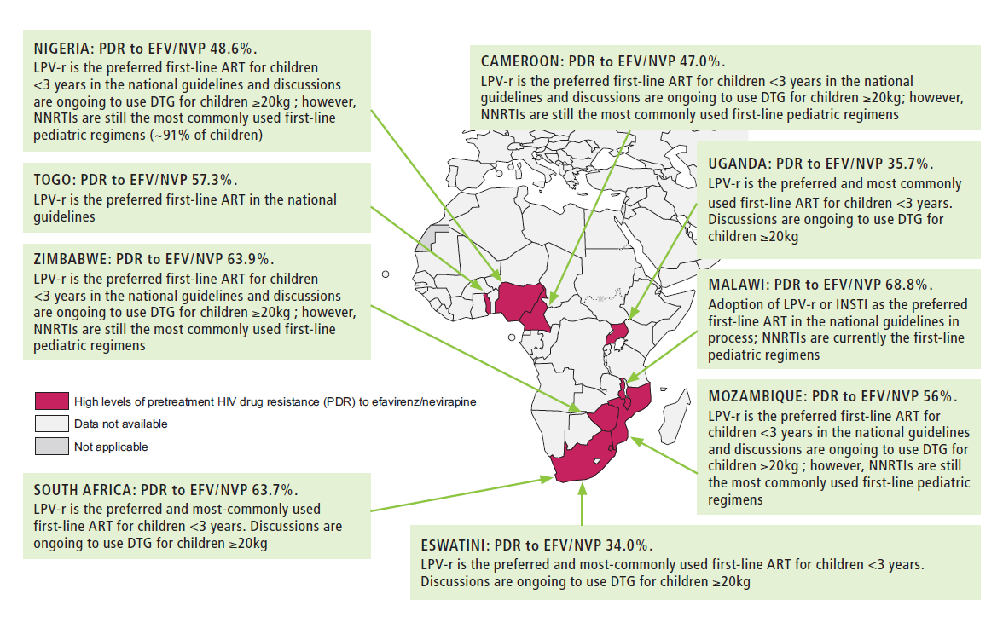
Response in Countries with High PDR to NNRTI in Infants

Slide 12
Prevalence of NRTI PDR in Infants Newly Diagnosed with HIV, by Drug and Country
2%- 23%
1.8%-18%
1.8%-16%

Slide 13
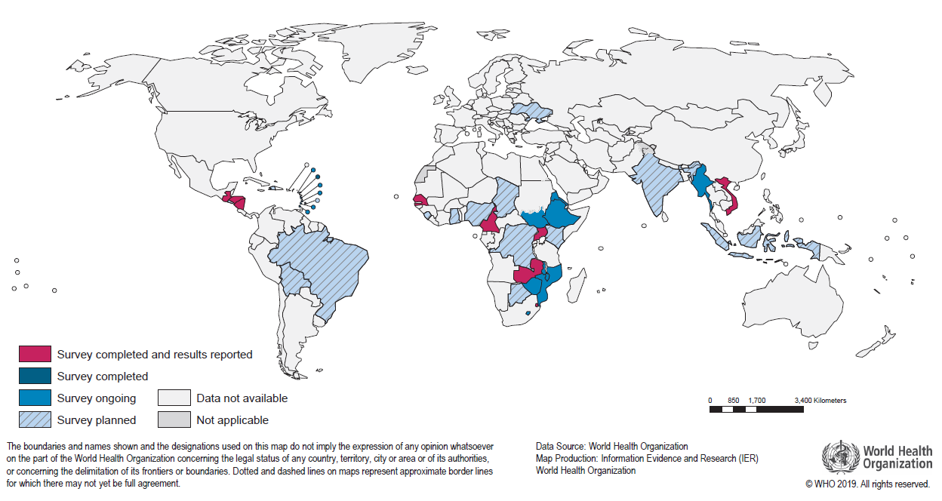
Nationally Representative Surveys of
Acquired HIVDR among Adults Receiving ART (2014-2018)
19 completed,
26 ongoing,
15 planned

Slide 14
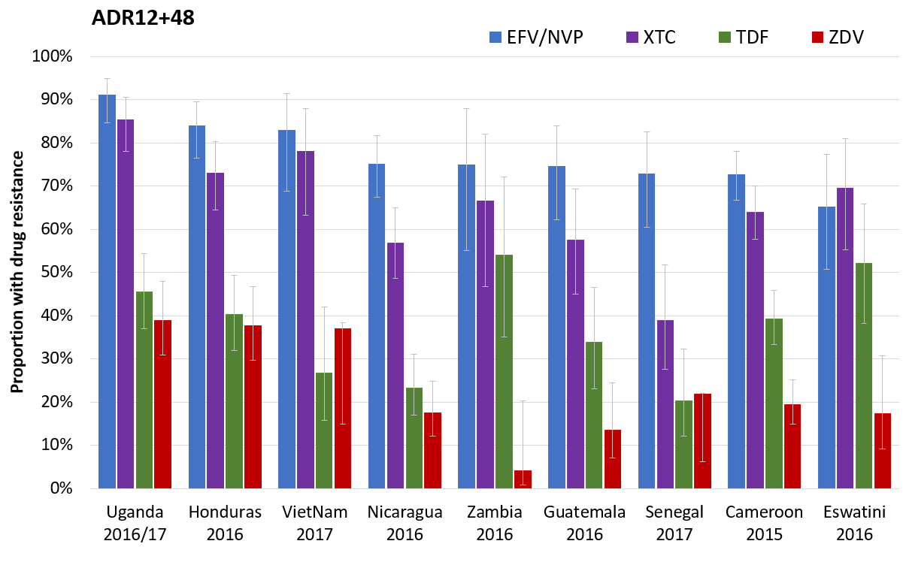
Prevalence of Acquired HIVDR among Adults with Unsuppressed VL Receiving Any ART Regimen, by Drug
67%-90%
39%-85%
20%-55%
4%-40%
ADR in people on ART ranged from 3% (Viet Nam) to 29% (Honduras).
(national HIVDR surveys)
Notes:
ADR NNRTI 67-90%
TDF: 20-55%
ZVD: 4-40%
Note that not all people were on TDF
Prevalence of ANY DR ranged from 3% in Vietnam to 29% in Honduras.

Slide 15
Conclusions
High levels of NNRTI PDR among adults starting ART observed in most of the countries monitored, supporting WHO guidelines to use DTG as the preferred option to initiate ART.
NNRTI PDR is significantly higher in subpopulations such as ART starters reporting prior ARV drug exposure and in women, emphasizing the need to provide access to DTG in these groups, as recommended by WHO.
NRTI PDR was generally lower but not insignificant in some countries.
In newly diagnosed infants, NNRTI PDR is very high in all countries monitored, supporting the need to implement WHO guidelines to use PIs or DTG in first-line ART in children. PDR to ABC is high in some countries, warranting attention.
Acquired HIVDR to NNRTIs is very common (67%-90%) in people with viral load non- suppression. Resistance to TDF/XTC is also frequent. Further research is needed to assess the efficacy of DTG when administered with a compromised NRTI backbone.
To ensure long term durability of TLD, routine HIVDR surveillance is needed to monitor for the emergence of resistance.

Slide 16
Ackowledgements
National HIV programme who supplied the surveillance data and staff from WHO regional and country offices
Seth Inzaule, Amalia Girón, Neil Parkin, Michael R. Jordan, Natalie Exner, Fatim Cham, Giovanni Ravasi, Linh Le and B.B.Rewari
HIVResNet steering group members
WHO HIVResNet Laboratory Network members
CDC, PEPFAR and Global Fund for the support of the HIVDR surveys.

